Slide 1


Exercise #5
Design a Panel
Aims:
Design an 11-color panel:
Classify the antigens
Consider co-expression
Characterize spread of available fluorochromes
Assign fluorochromes
© 2021 Cytek Biosciences, Inc.

Slide 2
Exercise 5 Steps to Assigning Fluors in a Panel
1
Classify the antigens
Define a gating strategy
Consider co-expression
Assess reagent availability
2
Characterize uniqueness, brightness, and spread of available dyes
3
Assign fluorochromes
Tertiary antigens: Use very bright/bright dyes that receive low spread
Secondary antigens: Assign based on co-expression:
- If no co-expression, use any bright dye still available
- If co-expression, use bright dyes that don’t spread into tertiary antigens
Primary antigens: Use dim fluors that contribute low spread
© 2021 Cytek Biosciences, Inc.

Slide 3
Exercise 5 Gating Strategy
CD3⁺
CD4⁻
CD4
CD3⁻
CD3
Classification | Specificity | Alt Name | Purpose
2 | CD2 | LFA-2 | NK cells
2 | CD16 | FCgRIII
2 | CD56 | NCAM
2 | CD8
1 | CD3 |  | non-NK cells
1 | CD4
3 | CD158a | KIR2DL1 | NK receptors
3 | CD158b | KIR2DL2
3 | CD314 | NKG2D
3 | CD335 | NKp46
3 | CD337 | NKp30
NKT cells
NKT cells
CD158a
CD158b
CD314
CD335
CD337
CD16
CD8
CD56
CD56
CD56
NK cells
CD158a
CD158b
CD314
CD335
CD337
CD16
CD56
CD2
© 2021 Cytek Biosciences, Inc.

Slide 4
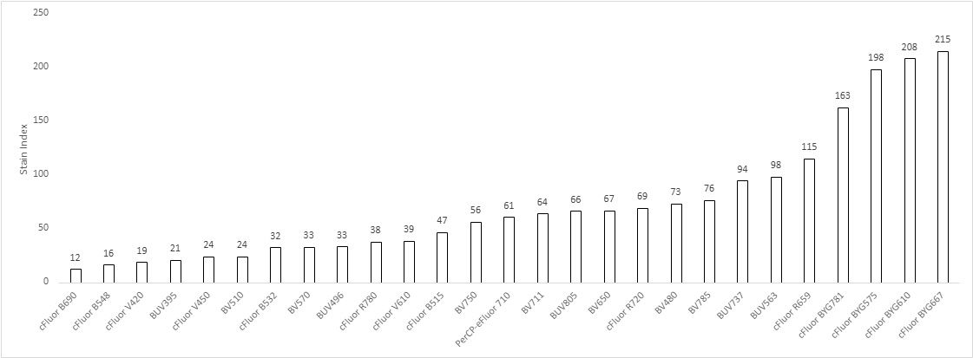
Exercise 5 Fluorochrome Brightness
Dim
Mid
Bright
Very Bright
© 2021 Cytek Biosciences, Inc.

Slide 5
Exercise 5 Reagent Availability
 |  |  | CD2 | CD16 | CD56 | CD8 | CD3 | CD4 | CD158a | CD158b | CD314 | CD335 | CD337
Fluorochrome Brightness ( SI) | Very Bright | cFluor BYG667 | x | x | x | x | x | x | x | x | x
 |  | cFluor BYG610 | x | x | x | x | x | x | x | x |  | x | x
 |  | cFluor BYG575 | x | x | x | x | x | x |  |  | x | x | x
 |  | cFluor BYG781 | x | x | x | x | x | x | x | x | x | x | x
 |  | cFluor R659 | x | x |  |  | x | x | x | x |  | x | x
 | Bright | BUV563 | x | x | x | x | x | x | x | x | x
 |  | BUV737 | x | x | x | x | x | x | x | x | x | x | x
 |  | BV785 | x | x | x | x | x | x |  |  | x | x | x
 |  | BV480 | x | x | x | x | x | x | x | x |  | x | x
 |  | cFluor R720 | x | x | x | x | x | x | x | x | x | x | x
 |  | BV650 |  |  | x | x | x | x | x | x | x |  | x
 |  | BUV805 | x | x | x | x |  | x | x | x | x | x | x
 |  | BV711 | x | x | x | x | x | x | x
 |  | PerCP-eFluor 710 | x | x | x | x | x | x | x
 |  | BV750 | x | x | x | x | x | x | x | x | x | x | x
 | Mid | cFluor B515 | x | x | x | x | x | x | x | x | x | x | x
 |  | cFluor V610 | x | x | x | x | x | x |  | x | x |  | x
 |  | cFluor R780 | x | x | x | x | x | x | x | x | x | x | x
 |  | BUV496 | x | x | x | x | x | x |  |  |  | x | x
 |  | BV570 | x | x | x |  |  | x | x | x | x | x | x
 |  | cFluor B532 | x | x | x | x | x | x | x | x | x | x | x
 | Dim | BV510 | x | x | x | x | x | x | x | x | x
 |  | cFluor V450 | x | x | x | x | x | x |  | x | x | x | x
 |  | BUV395 | x | x | x | x | x | x | x | x
 |  | cFluor V420 | x | x | x | x | x | x | x | x | x | x | x
 |  | cFluor B548 |  |  |  |  |  | x | x |  |  | x | x
 |  | cFluor B690 | x | x | x | x | x | x
© 2021 Cytek Biosciences, Inc.

Slide 6
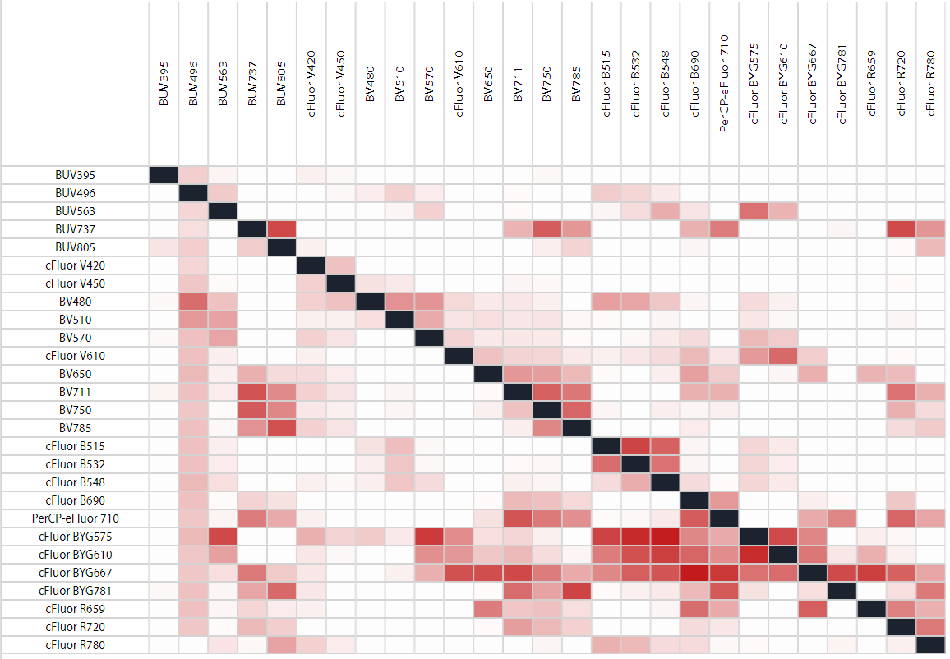
Exercise 5 Fluorochrome Spread
Stain Index Reduction (SIR) Matrix
Dye in row impacts dye in column
Into
No Impact
High Impact
From
© 2021 Cytek Biosciences, Inc.

Slide 7
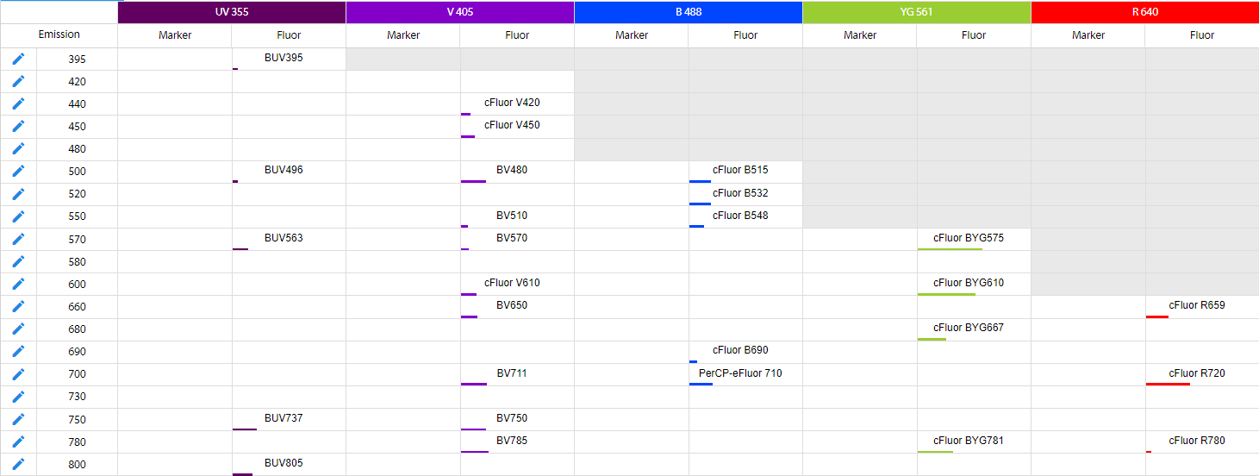
Classification | Specificity | Purpose
2 | CD2 | NK cells
2 | CD16
2 | CD56
2 | CD8
1 | CD3 | non-NK cells
1 | CD4
3 | CD158a | NK receptors
3 | CD158b
3 | CD314
3 | CD335
3 | CD337
Exercise 5 Fluor Assignment
Drag and drop the markers into position on grid based on your design
CD3
CD56
CD16
CD8
CD4
CD337
CD2
CD335
CD158a
CD314
CD158b
© 2021 Cytek Biosciences, Inc.

